Slide 1
DMAIC review template
Project title: <Title>
Project Type: <Lean / Lean Six Sigma>
Organization: <Name organization>
Project manager: <Name Belt>
Belt level: <Green Belt / Black Belt>
Date: -
Revision: v6.6

Slide 2
Introduction
Objective review template
  To submit the project for certification by the LSSA.
  To present the project in your own organization.
  Guidelines:
  The approach taken must be easy to follow for people with knowledge of Lean and/or Six Sigma.
  Avoid internal jargon.
  Explain abbreviations upon first use.
  In the speaker notes questions and guidelines can be found.
  At the end of each phase is a checklist to verify whether the right things have been paid attention to.
  Conclusions and decisions must be clear.
  As a guideline, follow this template tight when you submit the project. A maximum of 5 extra slides may be added.
Please delete this slide before submitting

Slide 3
DEFINE
1 – Define and Scope project
Problem description
.
SPECIFIC
MEASUREABLE
ATTAINABLE
RELEVANT
TIMELY
Objective
.
Notes:
Description of problem
Describe the problem. Why is the problem a problem?
Use techniques such as 5W2H; IS-IS NOT
If necessary, add a photo of the product if the problem can be made visible.
Note: the problem description does not contain any solutions
Objective
Describe as concretely as possible what you want to achieve
Together, the problem description and objective must be formulated SMART.

Slide 4
DEFINE
1 – Define and Scope project
KPIs
Perf. measures
.
In Scope:
.
Out of Scope:
.
Deliverables:
.
Hard Benefits:
.
Soft Benefits:
.
Risk Assessment:
.
Notes:
KPIs / Performance measures: Indicate the most important KPIs / performance measures? How do we measure this?
In Scope: what is the demarcation of the project? What will the team focus on? (department, product, customer, machine, size?)
Out of Scope: what is the team not going to focus on? (department, product, customer, machine, size?
Deliverables: what are the tangible results: Which things (documents, process, …) will be delivered at the end of the project?
Hard benefits: provide the calculation that gives an estimate of the intended hard savings, on an annual basis (xxx k€ / year).
Soft benefits: describe additional benefits that cannot be expressed in money, such as satisfied customers and reduced work pressure.
Risk & control: what are the main risks of this project? How do you manage the risks?

Slide 5
DEFINE
2 – Define defect and CTQ(s)
x
x
x
CTQ_{ext}
CTQ_{int}
_{Specification}
_{Measurement method}
_{Measurement frequency}
_{Priority}
x
x
x
x
x
x
VOC/VOB
x
x
x
x
x
x
x
x
x
x
x
x
x
Notes:
VOC: Voice of Customer can be vague and comes from e.g. Net Promoter Score, KANO, Pareto etc.
VOB: Voice of Business is about the requirements/wishes of the 'Internal customer' or about the importance for the Organization as a whole.
CTQext: The CTQext is the measurable quantity on which the customer judges the product/service. This number is linked to 'the problem' or 'the complaint' or 'the failure’
CTQint: The CTQint is the measurable quantity on which the internal organization measures the quality of the product or service. Is this value good enough to satisfy the CTQext?

Slide 6
DEFINE
3 – Plan and document project
Project Team
Resource Mgr
Champion
User
MBB
.
.
.
.
Project Mgr (Belt)
.
Name
Role
Responsibility
.
.
.
Notes:
Supplier (optional): internal manager who is assigning resources to the project
Champion: Business owner or the person who has initiated this project.
User (optional): represents the department that will reap the benefits from the project
MBB: Internal or external Coach for the Belt
Team: team members and resources in the project

Slide 7
Define
3 – Plan and document project
Employee involvement in the project / process
  …
Conclusion:
Notes:
Which employees will be part of the new process, who will take part?
Is there resistance to change?
Explain how to inform and motivate those coworkers who are not part of the steering team, but will be part of the development/changes.
And develop a communication plan for this.

Slide 8
DEFINE
3 – Plan and document project
SIPOC
Suppliers | Inputs |  |  | Process | Outputs |  | Customers
 |  | Specification | Type |  |  | Specification
START
END
.
.
.
.
.
.
Notes:
A SIPOC or a Spaghetti diagram is mandatory for process improvement to visualize the project on a high level
Suppliers: Those who provide the inputs
Inputs: Input variables: Controllable variables + specs, main noises, SOPs
Process: If helpful show below detailed steps on the process
Outputs: Output variables
Customers: Those who receive the product or service

Slide 9
DEFINE
Assessment
Check: are the elements below addressed in the Define phase?
  Project addresses a clear problem description or business opportunity.
  Problem description has been clearly defined.
  Goals have been clearly defined and are measurable.
  VOC and VOB have been clearly defined and requirements are understood.
  Scope of the project has been clearly delineated.
  Key stakeholders have been identified.
  Relevant CTQ(s) have been selected and a CTQ-flowdown has been constructed.
  High level process description has been made (e.g. SIPOC).

Slide 10
MEASURE
4 – Evaluate measurement system
Evaluate the quality of the data and the measurement system
  …
Conclusion:
Notes:
Lean project: provide an assessment of the accuracy (no systematic deviation) and reliability of the data.
Six Sigma project: show the results of the measurement system analysis (MSA) for the reliability of the data, including the conclusions that are drawn from it.
Describe the source and quality of the used data.
Describe how the data is collected.
How is the quality of data tested, MSA performed?
The CTQint are the measurable units on which the quality of the internal organization or service is measured. How reliable is this data?
The data must be reliable such that it can be used as facts in the next phases of the improvement process.

Slide 11
MEASURE
5 – Establish baseline
Current (historic) performance of the process / CTQ
  …
Conclusion:
Notes:
How is the situation on the CTQs in the beginning of the project? (measured with the known error) e.g. results of capability & performance study
If historical measurement error is unknown, add a note.
Visualize if possible, for instance in time.

Slide 12
MEASURE
6 – Set improvement goals
Improvement objectives for the CTQs
  …
Conclusion:
Notes:
Evaluate whether the original CTQ int and/or goals are realistic. If necessary describe the rational why the targets are being adjusted.
Connect the goals to the CTQint.
If the CTQint measurement value has been reached, is the problem solved? Is the customer or organization satisfied?

Slide 13
Measure
Assessment
Check: are the elements below addressed in the Measure phase?
  The collected data has been proven to be representative for the project.
  Validity of the data has been verified in an appropriate way.
  Historical data has been used to visualize process performance over time.
  Performance against requirements has been verified.
  For a Six Sigma project:
  A measurement system analysis (MSA) has been performed.
  Variation in the process has been considered (common cause or special cause).
  Short term versus long term performance has been considered.

Slide 14
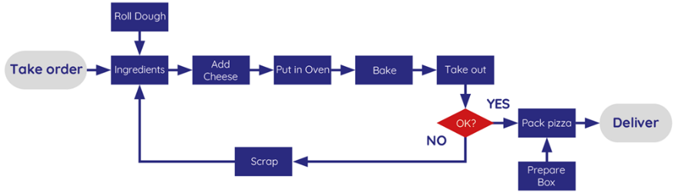
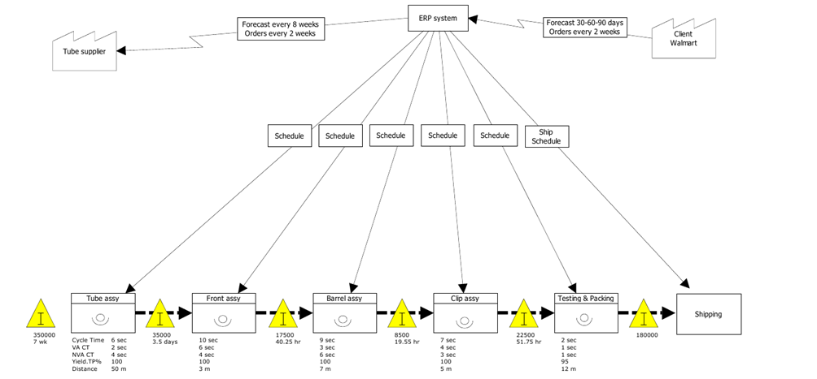
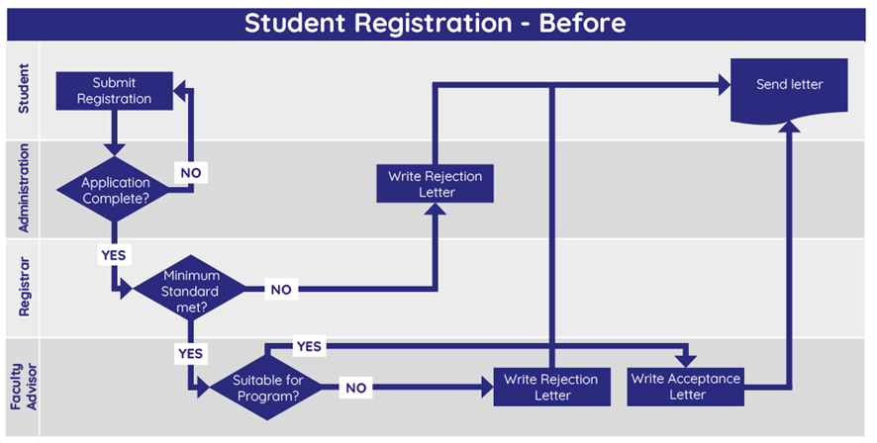
ANALYZE
7 – Map process and identify inputs
Process map
Conclusion:
Notes:
Suggestion:
Use a flowchart for a project with quality issues (rework and defects).
Use a Swimlane to distinguish responsibilities of sub-processes within the total process.
Use a VSM Current State for a project with lead time or work in progress issues.

Slide 15
ANALYZE
8 – Isolate key inputs (X_{1..n})
Factors of influence (Xs) on the process / CTQs
Measurement
Machine
Man
Problem
Environment
Method
Material
Conclusion:
Notes:
Make use of a brainstorm session with the team to create this diagram to complete and categorize the list of inputs
If a large number of inputs is identified, it is important to limit the analysis to a small set of important (key)inputs.
Place a list of key inputs for poor performance of your process

Slide 16
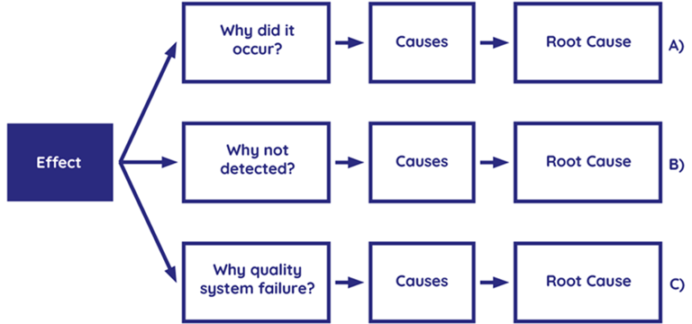
ANALYZE
9 – Develop relation between inputs and Output Y = f(X_{i})
Root Cause of the problem
  …
Relationship between the key inputs (X) and output (Y)
  …
Conclusion:
Notes:
5-Why: ask the why question five times to get to the root cause.
Indicate the root cause(s) for the problem. Justify this choice.
Provide evidence that there is a relationship between the stated root cause(s) and the performance of the process.

Slide 17
Analyze
Assessment
Check: are the elements below addressed in the Analyze phase?
  Process has been mapped in detail (e.g. VSM Current State).
  Potential factors of influence have been determined.
  Analysis have been used to identify factors with highest influence.
  Input data has been collected and analyzed correctly.
  Graphical techniques have been applied to investigate root causes.
  Major root causes have been identified.
  Conclusions are clear and have demonstrated strong evidence/are statistically valid.
  For a Six Sigma project:
  Hypothesis for root cause has been defined properly.
  Statistical techniques have been applied to investigate root causes.

Slide 18
IMPROVE
10 – Determine optimum settings
The new process and/or intended improvements
  …
Conclusion:
Notes:
VSM Future State: state the new or intended process description here by means of a VSM
or
Process map: description of the new process, method or technical solution.

Slide 19
IMPROVE
11 – Implement proposed improvement
Implemented improvements / realized actions
  …
Conclusion:
Notes:
Describe the implemented improvements
Tools: Kaizen projects, TPM, new specification, adjusted design, new tools, balancing, elimination of Muda, Muri, Mura, Poka Yoke, Standard Operating Instructions, etc.

Slide 20
IMPROVE
12 – Validate proposed improvement
Performance of the improved process / CTQ
  …
Conclusion:
Notes:
Here is a description of the results of the improved process.
Tools: (Rolled Throughtput) Yield improvement, Lead time improvement, Mail from happy customer, etc.
Have the (measurable) objectives been achieved?
What are the realized savings and how do they relate to the intended savings? (hard and soft)
Efficiency improvement, reduction of processing times or lead times, reduction of defects and scrap, improvement of OEE / TTE percentage etc.

Slide 21
Improve
Assessment
Check: are the elements below addressed in the Improve phase?
  Risks have been identified and addressed (e.g. pFMEA).
  Improved process meets the requirements of the VOC and VOB.
  There is a clear communication and action plan towards the stakeholders.
  The client (Champion) has approved the improvement proposal.
  An improvement of the CTQ compared to the baseline is demonstrated.
  For a Six Sigma project:
  There is evidence that the improvement is statistically significant.

Slide 22
CONTROL
13 – Implement control strategy
Evidence for assurance of the improvement
  CTQ of project is also monitored after project (possibly with SPC tools and OCAP)
  Drawings adjusted…
  Updated standards and work instructions…
  Documentation (FMEA, Control Plan, …)
  Employee training…
  System adjustments…
  Product iterations…
  Process performance monitoring (SPC, …)
Open actions
  …
  …
Notes:
Open actions: Actions and owners necessary should be well documented (who, what, when)
Documentation: How is assured that all information is well documented for future success, is everybody well informed and instructed
Roles & Responsibilities: What are the key roles & responsibilities to assure continued success, by name and action, explain how CTQ's are monitored in the future

Slide 23
CONTROL
14 – Close out project
Conclusions
  …
Recommendations
  …
  …
Lessons learned
  …
  …
Notes:
Conclusions: Relate this to the project objective, targets and deliverables
Recommendations: For follow-up, next steps, or next projects, spin-offs
Lessons learned:
What would you do differently next time
How to avoid that colleagues make the same mistakes next time
Was the organization cooperating, did you feel resistance to change and how to deal with this.
How to deal with cultural differences
From the Change Management point of view:
How did you manage the organization
Did you meet resistance to change and how did you respond to this?
Which cultural aspects did you encounter and how did you handle them?
What would you do different next time?

Slide 24
CONTROL
14 – Close out project
Realized hard benefits
  …
  …
Realized soft benefits
  …
  …
Signing
Champion:
Date, Name & Signature
-

Slide 25
Control
Assessment
Check: are the elements below addressed in the Control phase?
  Standards are adjusted and documentation has been updated (pFMEA, CP).
  Rolls and responsibilities have been described.
  Employees are instructed and/or trained.
  Evidence of 'In-Control situation' is available and sufficient.
  Improvements have proven to be sustainable.
  Measures have been put in place to monitor process performance.
  Project report has been completed. Lessons learned have been communicated.
  Champion states that project targets and/or savings have been achieved.
  Champion or controller has signed off the project.

Slide 26
LSSA Feedback summary
According to the LSSA guidelines, this project is [Passed / Failed]
for [Lean / Lean Six Sigma] at the level of [Green Belt / Black Belt]
  General comments:
  Define:
  Measure:
  Analyze:
  Improve:
  Control:

